Slide 1
Contemporary Tourism
Contemporary Tourism Product Markets

Slide 2
Lecture Objectives
Understand the various approaches to tourism products
Appreciate the concept of experiences as tourism products
Recognise the various approaches to tourism markets
Be aware of the changing nature of tourism markets and the ‘post tourist’
Understand the significance of tourism market segmentation
Recognise the importance of the tourism product market
Recognise the importance of market stories in market shaping
Understand the nature of exchanges and interactions in tourism product markets

Slide 3
Tourism Products
Complex and multi-facetted
Debated
Package utilities and benefits
Traditional view of ‘exchange’

Slide 4
Contemporary View
Relationships
Co-creation
Bundles of intangible and tangible elements
Coordination of market actors

Slide 5
Kotler’s Approach
Core product
Facilitating product
Augmented product

Slide 6
Experiences
Pine and Gilmore’s experience economy
Changing values and authenticity
Engineered, formulated, staged and choreographed
Passive to active dimension
Personal, memorable and transforming

Slide 7
From Products to Experiences

Slide 8
Types of Experience Providers
Infusers – manufacturers who ‘infuse’ their products with experiences;
Enhancers – service providers who use experiences to heighten satisfaction or differentiate from competitors; and
Makers – service providers who create experiences as the core of their service.
All combine to deliver the experience

Slide 9
Definition of a Market
‘self-reproducing social structures among cliques of firms and other actors who evolve roles from observations of each other’s behaviour (White, 1981)

Slide 10
Tourism Markets
Products and markets evolve together
Based on interaction with the customer
Post tourist demands different approach

Slide 11
Segmentation
Measurable
Durable
Accessible
Substantial
Sustainable
Actionable

Slide 12
Tourism Product Markets
Framework of interaction between buyers and sellers
Marketplace
Interaction of products and markets
Assists in understanding types of tourism
Exchanges can be aggregated into product markets

Slide 13
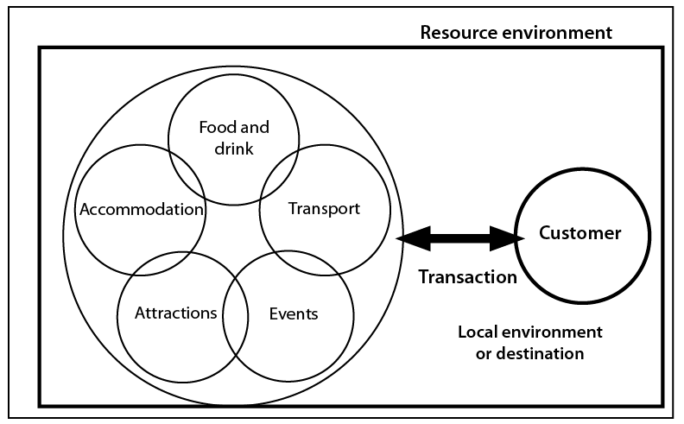
The Tourism Product Market

Slide 14
A Sociocognitive Market System

Slide 15
The Environment of Product Market Interactions

Slide 16
For Tourism
Definitions based on groups of product attributes
Identifies and delimits boundaries
Market stories
Interactions and exchanges
Service encounters

